Slide 1


Popular Route Planning with Travel Cost Estimation
Huiping Liu, Cheqing Jin, Aoyin Zhou
Institute for Data Science and Engineering, Software Engineering Institute,
East China Normal University, China

Slide 2
Agenda
Introduction
Overview
Popular Traverse Graph Construction
Travel Cost Modelling
Route Planning
Experiments
Conclusion
Notes:
Here is the agenda of my presentation. Firstly, I will briefly introduce the background of our work. Then, the overview of our solution. Subsequently, we details each main step of our method. Next, the results of experiments on large dataset will be displayed. I conclude our work at last.

Slide 3
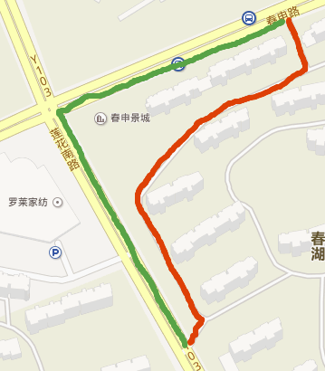




Introduction
Shortest or fastest path is not enough in route planning
B
A
Finding the Popular Route with Accurate Travel Cost Estimation
Notes:
The shortest or fastest path query is an important service in our daily life, and it’s a basic function in many map engines. However, in some cases, the shortest or fastest path is not enough.
(1)For example, we have two path from A to B, the green one is a path people usually travel, and the green one is a shortcut. Since the red path passes the residential district, it may be not convenient for new drivers or unfamiliar drivers. Thus, a popular route is demanded.
(2)Moreover, when taking a taxi, the travel cost (such as the travel time and the travel fee) will be a main consideration of the passengers. Therefore, an accurate estimation of the travel cost will improve the satisfaction of users. Hence, our goal is to find the popular route with accurate travel cost estimation.

Slide 4
Existing Work
Yuan J, Zheng Y, Zhang C, et al. T-drive: driving directions based on taxi trajectories. (SIGSPATIAL 2010)
Based on road network information
Practical fastest path is not always popular
Wang Y, Zheng Y, Xue Y. Travel time estimation of a path using sparse trajectories. (KDD 2014)
Travel time estimation of a given path
Can not be directly used in route planning
Notes:
Some existing works on the related problem has been published. T-drive aims to finding the practical fastest path from source to destination, it’s based on the road network information, however the road network is not always available, and the practical fastest path may not be popular. Another work focuses on travel time estimation of a given path on road network, but it can not be directly used in route planning. Therefore, we need to a new solution for our problem.

Slide 5
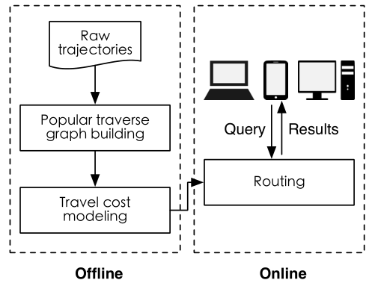
Overview
Notes:
To achieve this goal,
(1)We firstly construct a popular traverse graph from trajectories, where each node is a popular location and each edge is a popular path.
(2)Then for each popular path, the travel cost varies at different time, we model the travel cost on it using the MDL principle.
(3)Finally, on such graph, we devise a routing algorithm to find a popular route from the source and the destination at given time.

Slide 6
Popular Traverse Graph Construction
A popular route has a support ≥ τ (predefined)
Road network information is not always available.
We try to construct a popular traverse graph G=(V,E) from trajectories, where V is the set of popular locations and E is the set of popular routes between locations.
Notes:
First of all, we define the popular route whose support should be no less than τ, a threshold user predefined. However, the road network information is not always available, we cannot count the frequency of the road to find the popular routes. Hence, we try to construct a popular traverse graph G=(V,E) from trajectories, where V is the set of popular locations and E is the set of popular routes between locations. Then we can do routing on such graph given the start and end locations.
(1)For example, we want to construct a popular traverse graph for these trajectories.

Slide 7
Popular Traverse Graph Construction
A popular route has a support ≥ τ (predefined)
Road network information is not always available.
We try to construct a popular traverse graph G=(V,E) from trajectories, where V is the set of popular locations and E is the set of popular routes between locations.
Points clustering
Notes:
(1) Firstly, for all the points in these trajectories, we apply a DBSCAN clustering for them, then we can find the popular locations or areas where people usually travel.
(2)To reduce the size of points, we can only consider the end points of each trajectory, also we can divide these points into different zones and cluster the points in each different zones.

Slide 8
Popular Traverse Graph Construction
A popular route has a support ≥ τ (predefined)
Road network information is not always available.
We try to construct a popular traverse graph G=(V,E) from trajectories, where V is the set of popular locations and E is the set of popular routes between locations.
Points clustering
Trajectory clustering
(τ = 2)
Notes:
After having the popular locations, for each pair of location, we cluster the trajectories between them and regard the cluster with at least τ trajectories in it as the popular route between the two popular locations. In our example, τ equals to 2, hence we get four popular routes in total. Then the popular traverse graph has been constructed from these trajectories.

Slide 9
Modeling travel cost on popular route
The travel cost on each route varies at different time
We mining the travel cost pattern at different time slots for an accurate time cost estimation
A good partition for the travel costs into different time slots should satisfy the following two conditions
homogeneity: stable travel costs in each time slot
conciseness: the significant difference (i.e., distribution) between two adjacent time slots
Notes:
After the popular traverse graph is ready, we compute the travel cost on each popular route. Since the travel cost on each route varies at different time, for an accurate travel cost estimation, we mining the travel cost pattern for each popular route at different time slots. That is we want to find a partition for the travel costs into different time slots. We note that a good partition should satisfy two conditions.
(1) The first one is homogeneity, that is the travel costs in the same time slot should be stable enough so that it can reflect the traffic pattern
(2) And the second one is conciseness, that is the travel costs in adjacent time slots should be different (such as the distribution of the travel costs), otherwise, there is no need to split them apart.
Moreover, the more homorganic and concise, the better.

Slide 10
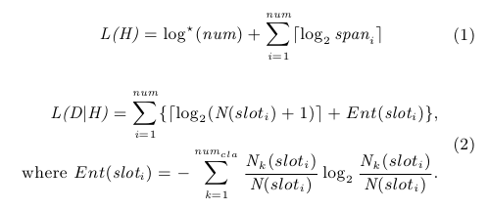
Modeling travel cost on popular route
MDL = L(H) + L(D|H)
L(H): description of the hypothesis
L(D|H) : description of data under the hypothesis
To get the best hypothesis to explain the data, the value of L(H) + L(D|H) must be minimized
Our data is the travel costs on each popular route
Our hypothesis is the partition
Conciseness
Homogeneity
Notes:
To describe these two conditions, we use the MDL principle which describes the data under a hypothesis. The MDL cost consists of two components: L(H) and L(D|H), where L(H) is the length of the description of the hypothesis, and L(D|H) is the length of the description of data under the hypothesis, both in bits. To get the best hypothesis to explain the data, the value of L(H) + L(D|H) must be minimized. In this problem, our data is the travel costs on each popular route, and our hypothesis is the partition. Hence, L(H) and L(D|H) are defined formally by following equations.
In Equation (1), the first term describes the number of time slots of our partition, the second term describes the span of all time slot. Thus, Equation (1) describes the conciseness.
In Equation (2), the first term encodes the number of the travel costs in the time slot, and the second term computes the information entropy to describe the stability of the travel cost in that slot. By summing up the values of all the time slots in our partition, which will describes the Homogeneity of our partition.
To find the optimal partition, we should make the MDL cost minimal.

Slide 11
Modeling travel cost on popular route
An approximate algorithm to find the approximate optimal partitioning
Initial partition only contains one slot
Each time, we find a new splitting point on the slot who has maximum information entropy
Compute the new MDL cost of the new partition
Initial partition
New partition
Notes:
Here, we use an approximate algorithm to find the approximate optimal partitioning. We do it in a greedy manner:
(1)Firstly, we have the initial partition only contains one slot
(2)Next, each time, we find a new splitting point on the slot with maximum information entropy, the new splitting point should makes the sum of entropies of the two new slots minimized
(3)Then, we compute the MDL cost of the new partition, if the new MDL cost decreases, we continue to find new splitting point. Otherwise, we have found the approximate optimal partitioning. Since, no partition can be found to make the MDL cost smaller.

Slide 12

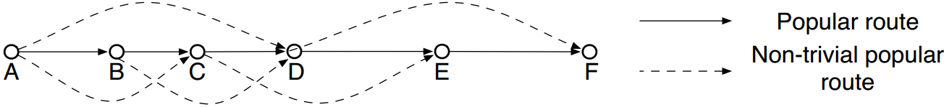
Route Planning - Optimal Concatenation
The optimal concatenation of a path (KDD 2014)
A path has different concatenations of segments
The optimal concatenation which makes the object function minimized will yield the least empirical risk when estimate the travel cost
Notes:
Now, we find route on the popular traverse graph based on query. To accurately estimate the travel cost of a path, we consider the optimal concatenation of path. A path on the popular traverse graph may has different concatenations of segments, hence we have different ways to calculate its travel cost. And we need to find the best one which has an accurate cost of the path.
(1)In existing work, the optimal concatenation who yields the least empirical risk when estimate the travel cost has been studied. It is the one that makes the following object function minimized. Suppose the concatenation consists of k segments, for each segments, n_si represents the number of trajectories travelled on it, and c_si refers to the travel cost of the trajectories, we calculate their variance. By summing up all the values we will get the object function value of the concatenation.
(2)For example, A->B->C->D->E->F is a popular route on the popular traverse graph, if A->B->C->D have been travelled many times as a whole, then A->D will be a non-trivial popular route. Therefore, A->D->F is a different concatenation of the path A->B->C->D->E->F.

Slide 13
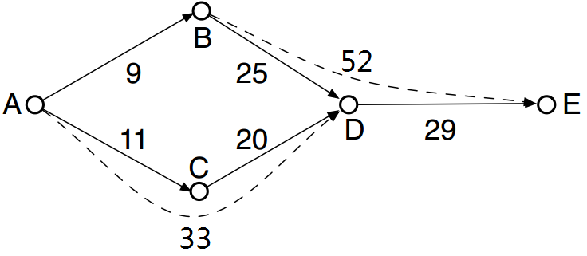
Route Planning
The route we expected from source to destination should holds two constrains:
it’s travel cost should be the cost of its optimal concatenation
It spends minimal travel cost among all possible paths under the former condition
The expected route from A to E will be A->B->D->E, its optimal concatenation is A->B->E which has minimal travel cost 61.
Notes:
So, given a source-destination pair, the route we expected from source to destination should holds two constrains:
First of all, the travel cost of the expected route should be the cost of its optimal concatenation, which guarantees the accuracy of the travel cost estimation
The second is that the expected route should spends minimal travel cost among all possible paths from source to destination
For example, this is a popular traverse graph, the solid lines are the popular routes on the graph and the dashed lines are the non-trivial popular routes, the numbers are the travel costs of the edges. We suppose the non-trivial popular routes are all the optimal concatenations. For path A->C->D, its optimal concatenations will be A->D with cost 33. Then the expected route from A to E will be A->B->D->E, which costs 61.

Slide 14
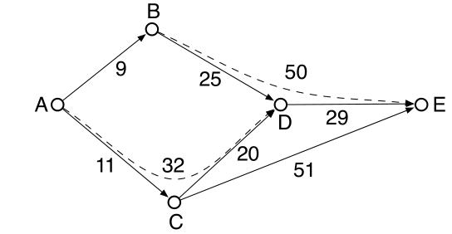
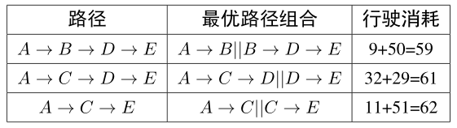

Route Planning
热门转换图
A到E的热门路径及其消耗
Notes:
So, given a source-destination pair, the route we expected from source to destination should holds two constrains:
First of all, the travel cost of the expected route should be the cost of its optimal concatenation, which guarantees the accuracy of the travel cost estimation
The second is that the expected route should spends minimal travel cost among all possible paths from source to destination
For example, this is a popular traverse graph, the solid lines are the popular routes on the graph and the dashed lines are the non-trivial popular routes, the numbers are the travel costs of the edges. We suppose the non-trivial popular routes are all the optimal concatenations. For path A->C->D, its optimal concatenations will be A->D with cost 33. Then the expected route from A to E will be A->B->D->E, which costs 61.

Slide 15
Route Planning - Algorithm
We use a dijkstra-like algorithm to find the expected route in the popular traverse graph
When we extend a node, we consider its outgoing edges and all the non-trivial popular routes start from it
For any path, we first find its optimal concatenation and calculate its travel cost
We update the travel cost of each node if its cost decreases
Notes:
We devise a dijkstra-like algorithm to find the expected route in the popular traverse graph. The main steps are listed below:
(1) When we extend a node, we consider its outgoing edges and all the non-trivial popular routes start from it
(2) For any path, we first find its optimal concatenation and then calculate its travel cost
(3) And we update the travel cost of each node if its cost decreases

Slide 16
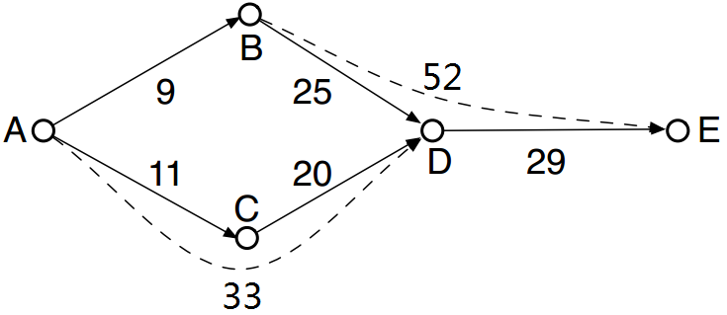
Route Planning – Running eaxmple
(9)
(11)
(33)
Original graph
Extending from A
(9)
(9)
(62)
(61)
(61)
(11)
(11)
(33)
(33)
(34)
Extending from B
Extending from D
Notes:
Here is a running example. For the popular traverse graph, we want to find the expected route from A to E.
(1)We start from A, and update the travel cost of B and C. Since A has a non-trivial popular route to D, the travel cost of D from A will be updated.
(2)Then we settle node B, since the cost of D from A doesn’t decrease, we will do nothing. And we update the cost of E through the non-trivial popular route B->E.
(3)Next, we settle C, since the cost of path A->C->D has been calculated, we won’t do anything to D.
(4)After setting D, the cost of E is determined and we find the expected path from A to E, which is A->B->D->E with cost 61.

Slide 17
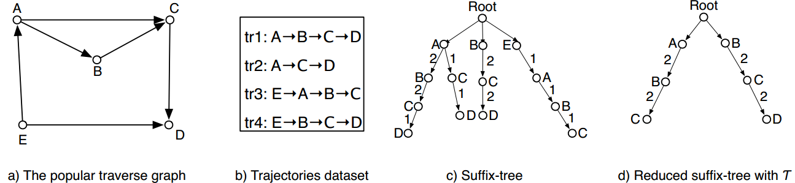
Route Planning
Finding the non-trivial popular routes and calculate the optimal concatenation of a route are time-consuming
We use a suffix tree to index the non-trivial popular routes
Pre-compute the optimal concatenation of some routes to improve the efficiency of route planning online
Notes:
For online queries, finding the non-trivial popular routes and calculate the optimal concatenation of a route are time-consuming.
(1)To quickly find the non-trivial popular routes, we use a suffix tree for trajectories to achieve this goal. By scanning the trajectory dataset, we can construct a suffix tree. In the suffix tree, we can easily get the non-trivial popular routes with a support threshold.
(2)To improve the efficiency of calculating the optimal concatenation of routes, we can pre-compute the optimal concatenation of the non-trivial popular routes on the suffix tree, which will save lots of online computations.

Slide 18
Experiments
Dataset
Trajectories generated by 13,007 taxicabs in Beijing from Oct. 1 to Oct. 31, 2013
We use the first 21 days’ dataset to construct the popular traverse graph and the last 10 days’ dataset are used for evaluation.
Popular traverse graph
The final PTG has 5,000 nodes and 33,357 popular routes
Testing set
Randomly choose 30,000 trajectories as queries
Distance:3km-18km, Travel time: 3min-60min
Notes:
Now, I will present our experiments.
(1)We use a large dataset which contains trajectories generated by more than 10 thousand taxis in Beijing from Oct. 1 to Oct. 31, 2013. We use the first 21 days’ dataset to construct the popular traverse graph, and the last 10 days’ dataset are used for evaluation.
(2)Our final popular traverse graph contains 5 thousand nodes and more than 30 thousand popular routes.
(3)And we randomly choose 30 thousand trajectories from the testing set as queries, and regard their travel time as the ground truth.

Slide 19
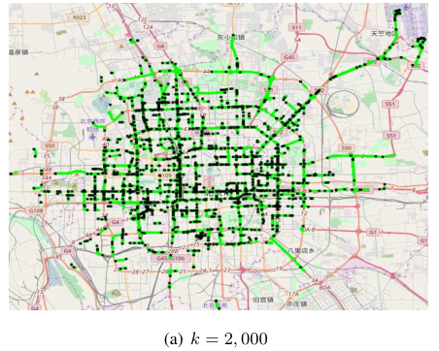
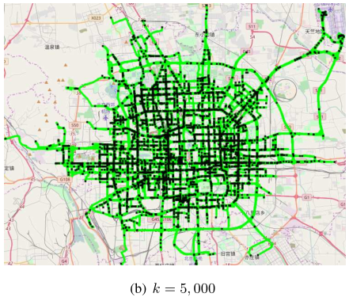
Experiments
Popular traverse graph
|V|=5,000 |E|=243,695
Notes:
Now, I will present our experiments.
(1)We use a large dataset which contains trajectories generated by more than 10 thousand taxis in Beijing from Oct. 1 to Oct. 31, 2013. We use the first 21 days’ dataset to construct the popular traverse graph, and the last 10 days’ dataset are used for evaluation.
(2)Our final popular traverse graph contains 5 thousand nodes and more than 30 thousand popular routes.
(3)And we randomly choose 30 thousand trajectories from the testing set as queries, and regard their travel time as the ground truth.

Slide 20
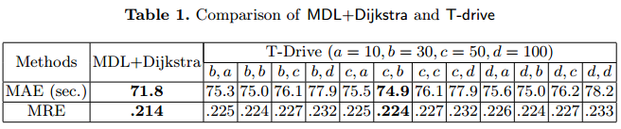
Experiments
The effectiveness of MDL
We use the VE-Clustering method on T-drive which are used to partition the travel costs on edges as the competitor of our method
Notes:
We first show the effectiveness of MDL, and we use the VE-Clustering method on T-drive which are used to partition the travel costs on edges as the competitor of our method. The results show that both the absolute error and relative error of our methods are smaller than VE-Clustering with different parameters.

Slide 21
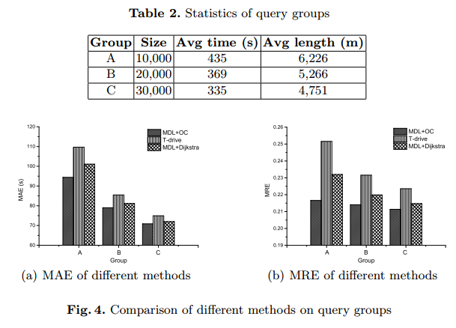
Experiments
The overall performance
Notes:
We then present the overall performance of our method. We generate three groups based on the 30 thousand queries. And based on each group, we test three methods, which are T-drive, the MDL simply plus dijkstra algorithm, and our method uses MDL and the optimal route concatenation. As we can see, our two methods outperform T-drive in terms of both the mean absolute error and the mean relative error, which indicate that both the MDL principle and the optimal route concatenation are effectiveness in travel cost estimation.

Slide 22
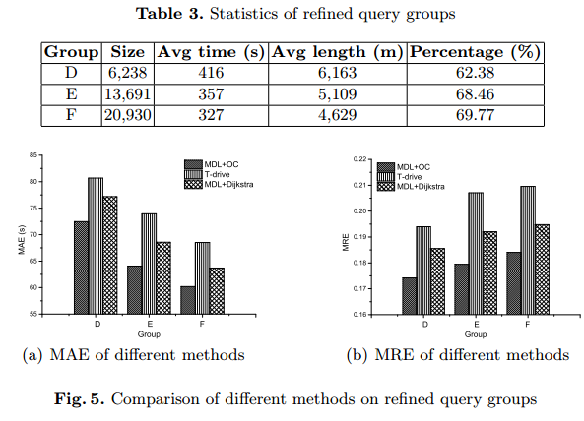
Experiments
The overall performance
Notes:
To reflect the real performance of our method, we remove the queries that follow different path as we recommended by our method and only keep the queries that share the same route as we found.
(1)As we can see, more than 60 percent queries in each group follow the same route as our method found. That is because people prefer to choose the popular route when they plan a trip.
(2)On the refined groups, all methods perform better. Still, our methods outperform T-drive and the performance gain of our method rises.

Slide 23
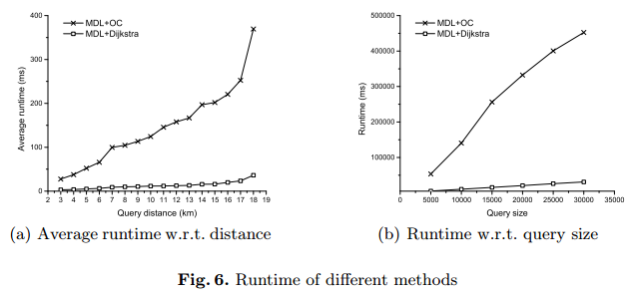
Experiments
The Efficiency
Notes:
Now, I present the efficiency of our method, since our method considers the optimal concatenation, it runs much slower than the dijkstra algorithm, but it can return the result far less than 1 second. And it scales well in different query size.

Slide 24
Conclusion
We propose a three-stage method to find the popular route without map given a source-destination pair
To accurately estimate the travel cost of the route, we first use MDL principle to model the travel cost on each popular route, and consider the optimal concatenation of path when finding route.
The experiments show that our method behaves well in terms of efficiency and effectiveness.
Notes:
Finally, I draw a conclusion of our work (1) We propose a three-stage method to find the popular route without map given a source-destination pair
(2) And to accurately estimate the travel cost of the route, we use MDL principle to model the travel cost on each popular route, and consider the optimal concatenation of path when finding route.
(3) finally, the experiments show that our method behaves well in terms of efficiency and effectiveness.

Slide 25
Thank You!
Q&A
Notes:
That all my presentation, thank you.

